Slide 1
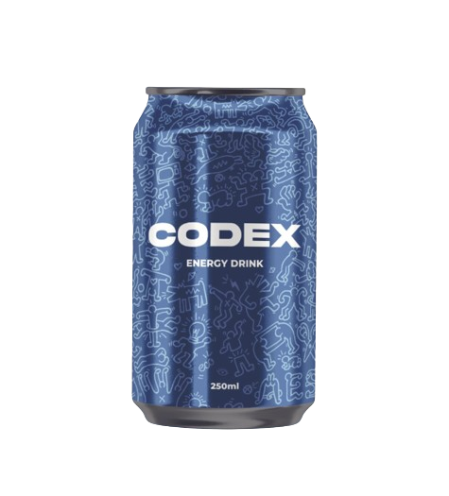
CODEX ENERGY DRINK
Presented By: D. Sohan Kumar

Slide 2






AGENDA
Overview Objective Data Primary Insights Secondary Insights recommendations

Slide 3
Overview
CodeX, a German Beverage Company, has launched an innovative energy drink in 10 cities across India, After Conducting an extensive survey to understand consumer preferences and cater to their needs.
By Gathering valuable insights through the survey, CodeX aims to shape effective marketing strategies, increase brand awareness, and capture a significant share of the Indian beverage market
Committed to delivering refreshing and enjoyable experiences, CodeX combines German excellence with local preferences, ensuring that their energy drink resonates with the Indian consumers.

Slide 4
Objective
1)
2)
3)
Recommendations for CodeX energy Drink
Analyse the data
Find Target Customers

Slide 5
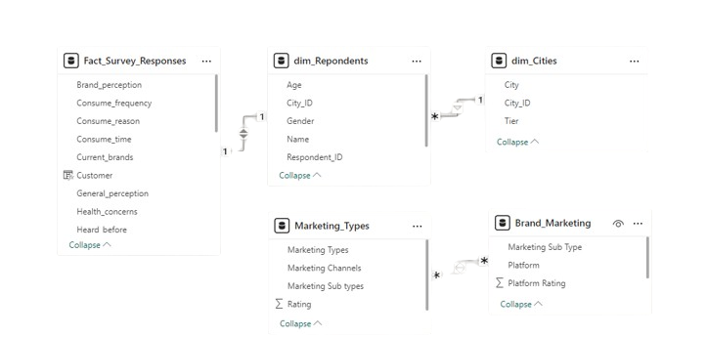
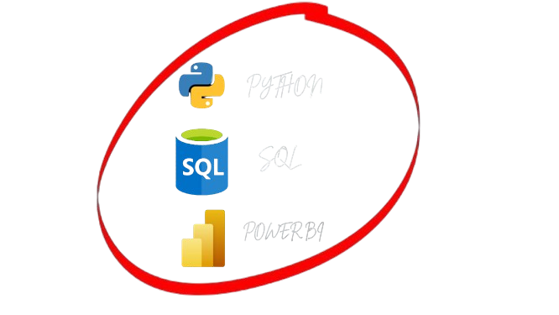
Data

Slide 6
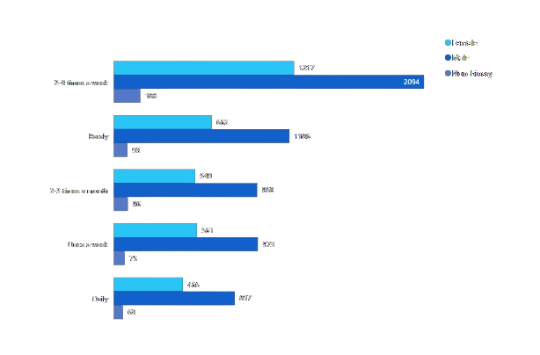
1. Who Prefers engery drirnk more? (Male, Female, Non-Binay)
Insights:
Male Highly Prefers Energy Drink
Among the Respondent 2.1K males show a high preference for the energy drink, consuming it at least 2-3 times a week.

Slide 7
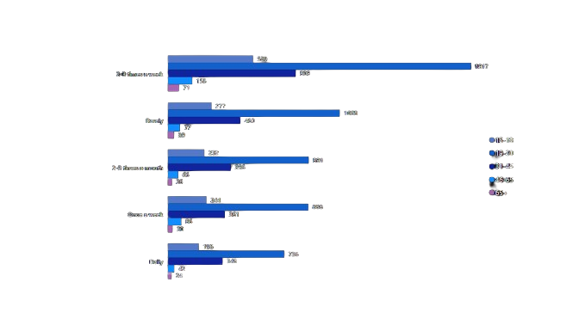
2. Which age group prefers energy drinks more?
Insights:
19-20 Age Group: Top Energy Drink Consumers
The 19-30 Age Group displays the highest prefrence for energy drink, followed by the 31-45 and 15-18

Slide 8
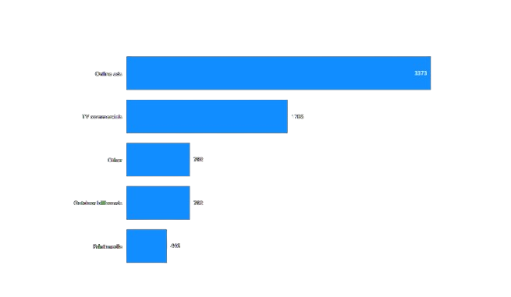
3. Which type of marketing reaches the most youth (15-30)?
Insights:
Online Ads: Youth’s Top Choice
Online Ads effectively reach the youth aged 15-30, with TV commercials being the next effective marketing channels

Slide 9
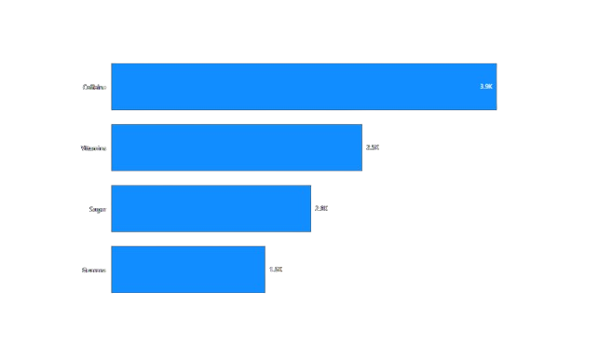
4. What are the preferred ingredients of energy drinks among respondents ?
Insights:
Caffeine: Energy Drink’s Key Ingredients
Caffeine and Vitamims are the preferred ingredients in energy drink among the respondent

Slide 10
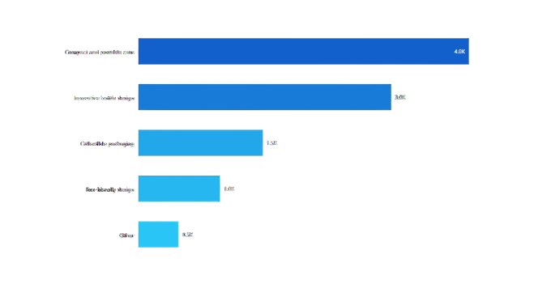
5. What Packaging preferences do respondents have for energy drinks?
Insights:
Go-To Packaging: Compact containers for energy drinks
Compact and portable cans are the top preferred packaging followed by innovative bottle designs.

Slide 11
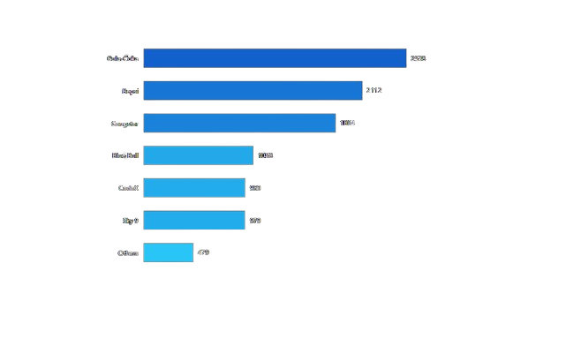
6. Who are the current market leader?
Insights:
Leading the Way: Cola-Coka, Bepsi, Ganster at the Top
Cola-Coka, Bepsi and Ganster rank as the top three energy drink brands, while CodeX holds a position within top 5.

Slide 12
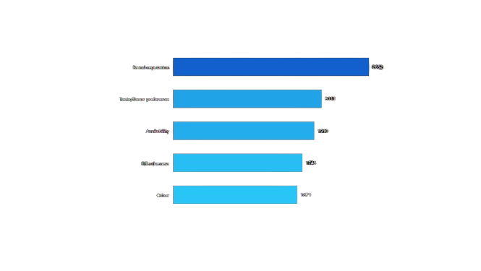
7. What are the primary reasons consumers prefer those brands over ours?
Insights:
Preferred Brands: Reputation, Taste and Accessibility win Consumers
Consumer preferences for energy drinks are influenced by brand reputation, a wide variety of flavors and product availibility.

Slide 13
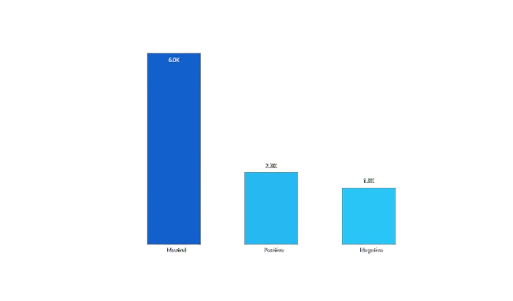
8. What do people think about our brand? (Rating)
Insights:
Brand Perception: Neutral Rating, Mixed Opinions
Around 60% of respondents gave mixed reviews, resulting in an overall ‘Neutral’ Brand Rating. This Indicates The Need Of Improvement.

Slide 14
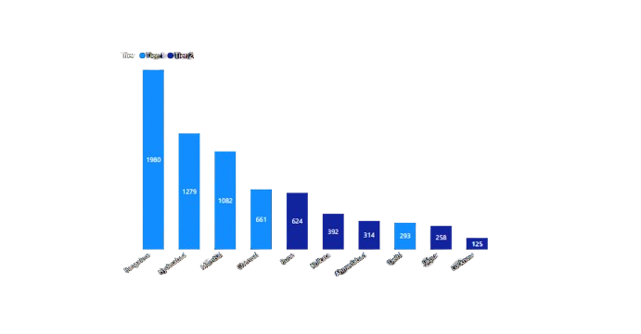
9. Which Cities do we need to focus more on? (15-30 age)
Insights:
Targeting Cities: Tier 1 and Tier 2 Hotspots for Brand Focus
It is advisable to focus on Bangalore, Hydrabad, Mumbai, Chennai from Tier 1 cities, along with Pune and Kolkata from Tier 2 Cities.

Slide 15
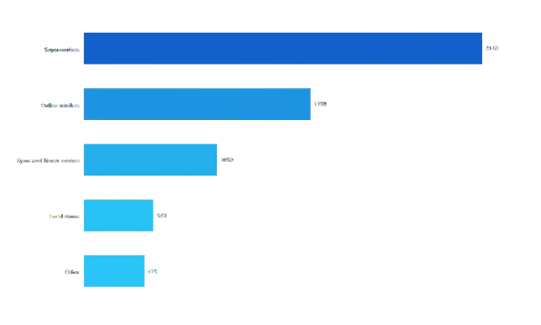
10. Where Do Respondent Prefer to Purchase Energy Drink?
Insights:
Ratail Preference: Supermarkets as Preferred Energy Drink outlets.
Supermarkets are the preferred location for purchasing energy drinks, followe by Online Retailers and Gyms.

Slide 16
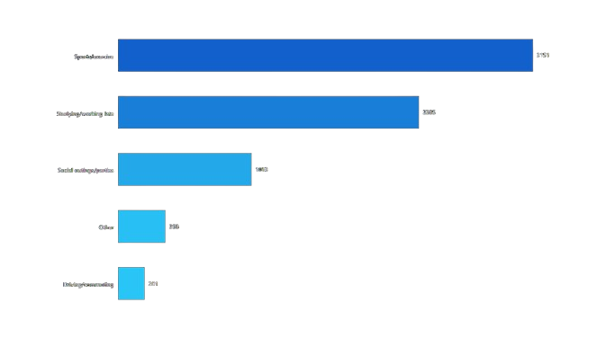
11. What are the typical consumption situations for energy drink among respondents?
Insights:
Emergize and Excel
The top consumption situations for energy drinks include sports and Exercise, Studying or working late follower by Parties.

Slide 17
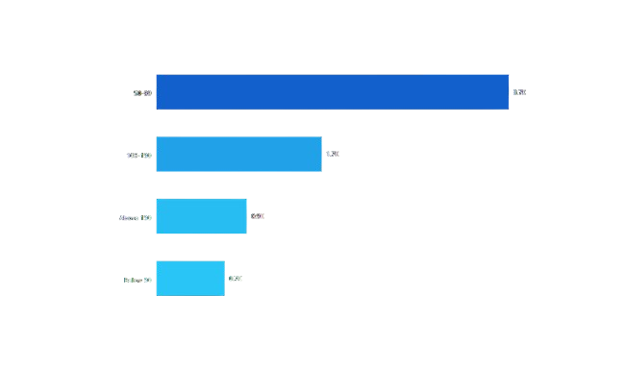
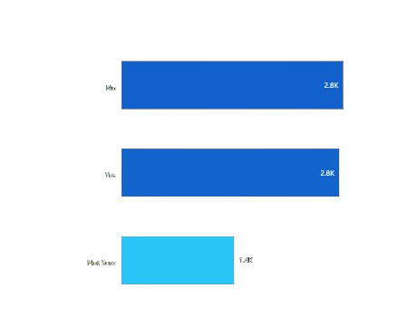
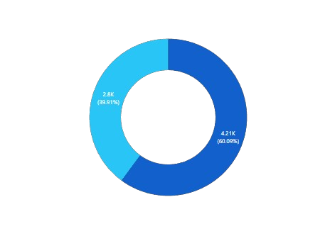
12. What factor influence respondent’s purchase decisions, such as
Insights:
Price Range
Health Concern
Limited Edition Packaging
Most Consumers prefers to purchase Energy Drink within the price range of 50-99 Rs. Additionally, 60% of respondent priortize Health, While 40% also show a preference for limited edition packaging

Slide 18
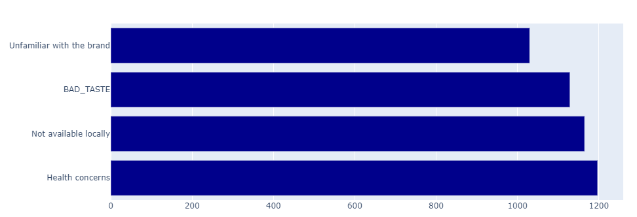
13. Which area Business should we Focus more on our product development? (Branding/Taste/Availability)
Insights:
Feedback
The key areas of focus for product development should be Taste improvement, ensuring widerspread availability, and incorporating health-Conscious Features to cater to customer preference and ehance the overall product experience

Slide 19
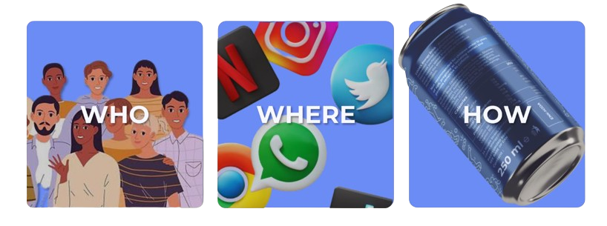
RECOMMENDATIONS

Slide 20

WHO
We Should Target males, aged 15-45 Years. Our aim is to reach our audience in major cities in Tier 1 and 2 like Bangalore, Hyderabad, Mumbai, Chennai, Delhi, Pune, Kolkata
Our Target Customer Consist of Two distinct Groups: Individuals who engage in sports and exercise activities, and those who are dedicated to studying or working late Hours.
To Successfully market our drink, we need to target health-conscious individuals who prioritize their well-being. By effectively engaging this audience , we can build brand loyalty and capture a significant market

Slide 21
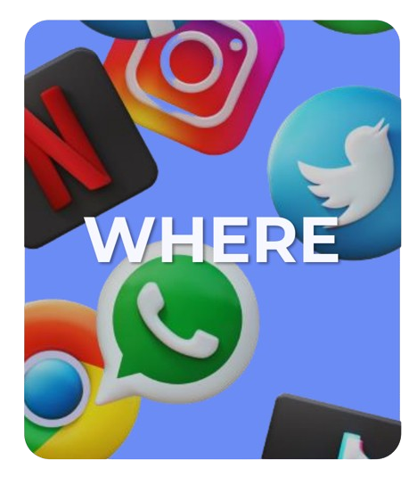
WHERE
Target Customer prefer online ads and lead active lifestyles, making influencer marketing on social media a key strategy to reach them.
We’ll build a vibrant brand community through social media, online ads, and TV commercials, while also organizing sports events to engage customers during physical activities
To amplify our marketing, a prominent sport or athlete with a strong social media presence will serve as brand ambassador, connecting with our target audience of age 15-45

Slide 22
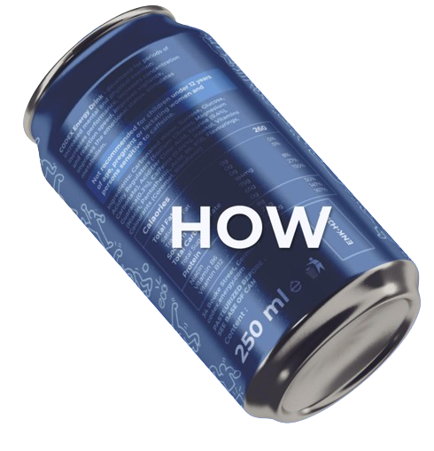
HOW
To market our drink effectively, we need to make it affordable within the preferred price range of 50-99 Rs, establishing it as a go-to option for customer.
To market our drink effectively, prioritize eco-friendly packaging, offer diverse flavors, highlight caffeine for an instant energy boost, and provide organic/healthy option.
To enhance marketing efforts, we can create limited edition drinks tied to trends, enticing customers to collect and try our energy drinks.

Slide 23
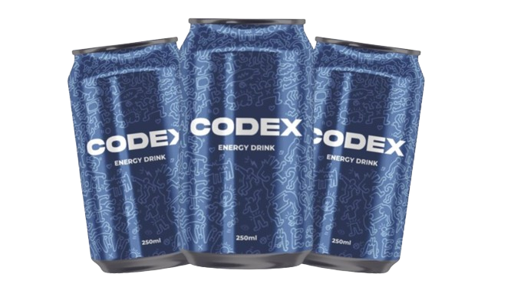


THANKS!
Do you have any questions?
dsohankumar123@gmail.com

